Slide 1


























Phonics

Slide 2


What is phonics?
Click on the speaker icon for the voice over

Slide 3
Phonics is…
skills of segmentation and blending
knowledge of the alphabetic code

Slide 4
Have a go at reading this to understand the complexity of the English language;
‘A moth is not a moth in mother, nor both in bother; broth in brother
And here is not a match for there, nor dear and fear for bear and pear;
And then there’s dose and rose and lose - just look them up - and goose and choose
And cork and work and card and ward, and font and front and word and sword,
And do and go and thwart and cart - come, come I’ve hardly made a start!
A dreadful language? Man alive! I’d mastered it when I was five!’
Michael Rosen

Slide 5
A simple view of reading
Word recognition (learning to read)
The ability to recognise and understand the words on the page
Language comprehension (reading to learn)
The ability to understand language
Click on the speaker icon for the voice over

Slide 6
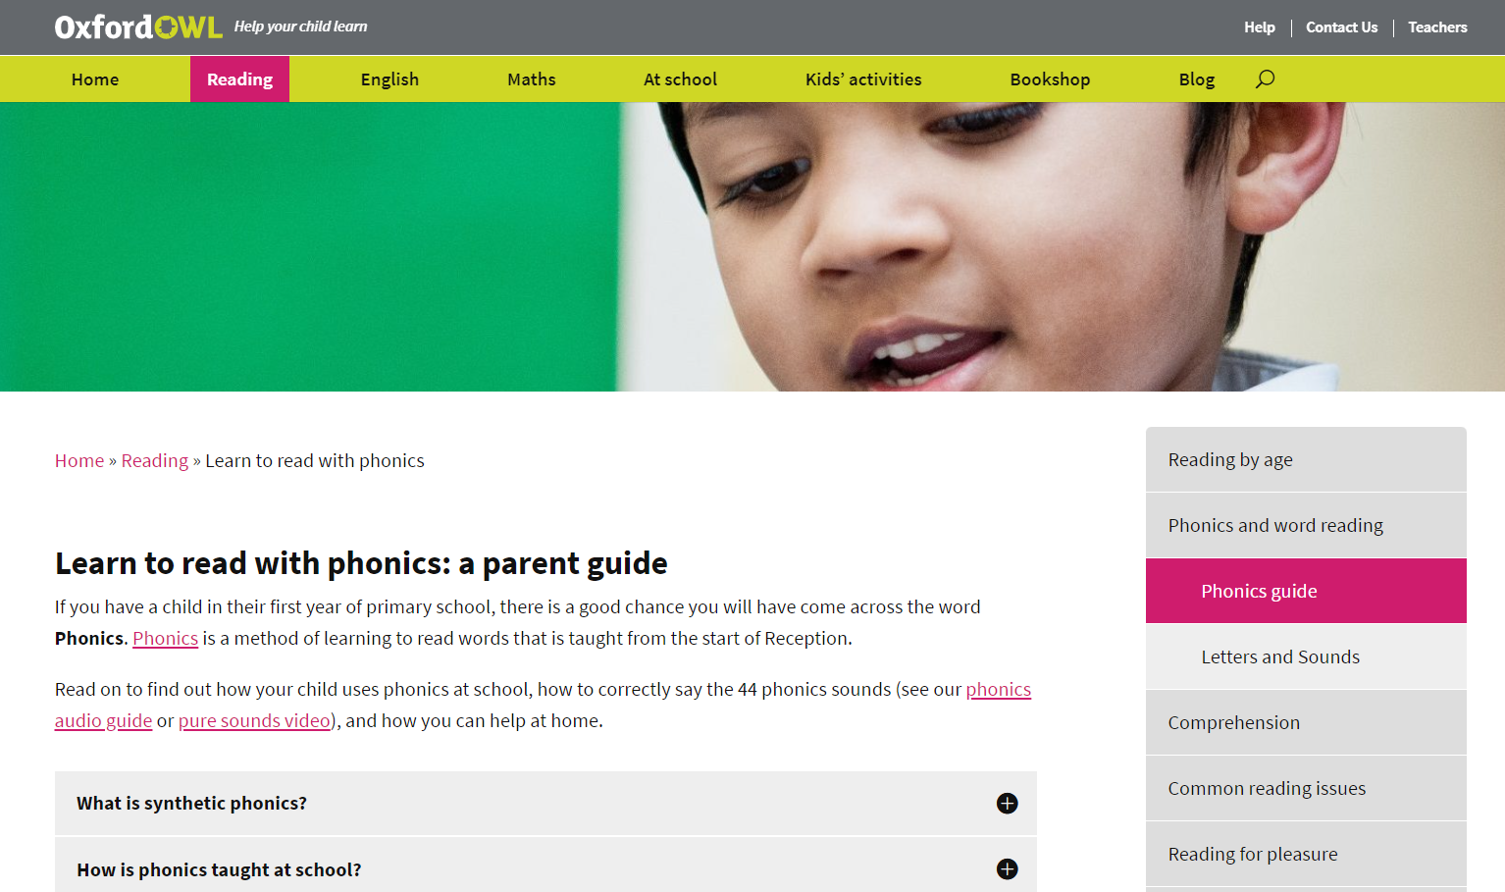
Videos and extra information
Please go to the Oxford Owl website where you can view some parent videos all about the teaching of phonics: Learn to read with phonics | Oxford Owl

Slide 7
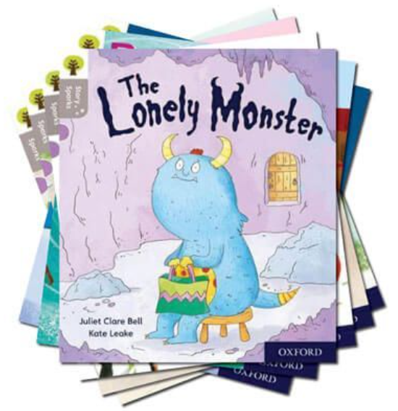
Wordless Books
(Lilac book band)
Click on the speaker icon for the voice over

Slide 8

Listening to your child read
Please support your child’s progress with their learning by listening to them read at least three times a week. This makes a huge difference to their progress and enjoyment of reading.
Please also make sure that you are writing a comment in their yellow reading log book about their bedtime book, their reading book or any comics or books that you are reading at home.
Click on the speaker icon for the voice over

Slide 9
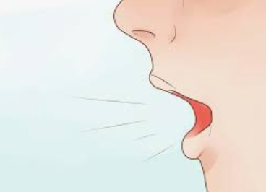
Enunciation
Enunciation is how we say each sound.
Sounds (phonemes) should be spoken very clearly to avoid any confusion.
Ensure that you are pronouncing the sounds correctly e.g. ‘mmm’ not ‘m-uh’.
Visit the Oxford Owl website for a guide for how to pronounce each sound correctly: Oxford Owl: Phonics

Slide 10
Blending and Segmenting
Blending
Recognising the letter sounds
in a written word, for example
c-u-p, and merging or synthesising
them in the order in which they
are written to pronounce the
word ‘cup’
Segmenting
Identifying the individual sounds in a spoken word (e.g. h-i-m) and writing down or manipulating letters for each sound to form the word ‘him’

Slide 11

Read Write Inc Order of teaching the sounds
Set 1
m a s d t i n p g o c k u b f e l h sh r j v y w th z ch qu x ng nk
Set 2
ay ee igh ow oo oo ar or air ir ou oy
Set 3
ea oi a-e i-e o-e u-e aw are ur er ow ai oa ew ire ear ure tion tiuos/cious
Click on the speaker icon for the voice over

Slide 12
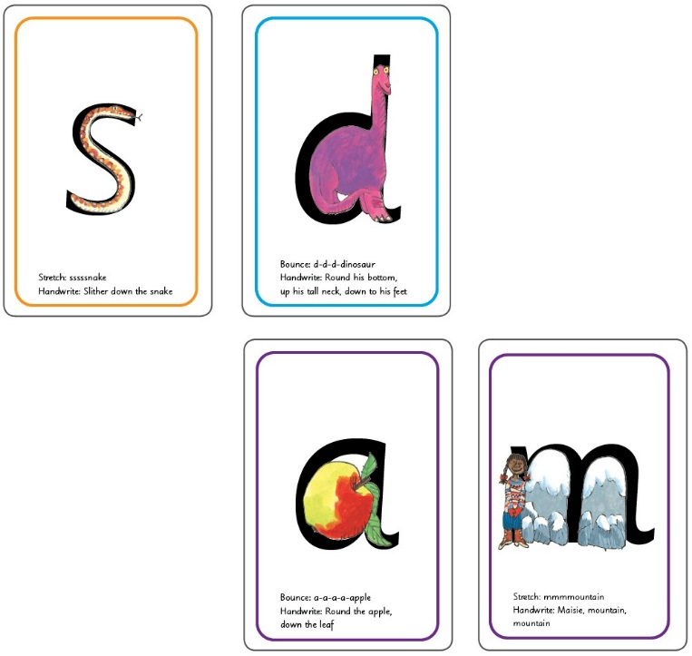
Blending and Segmenting
You can buy these online from Read Write Inc Website or Amazon; https://www.amazon.co.uk/Read-Write-Inc-Home-Flashcards/dp/0198386710
After Christmas, these cards would also be helpful; https://www.amazon.co.uk/Read-Write-Inc-Phonics-Flashcards/dp/0198386818/ref=redir_mobile_desktop?ie=UTF8&aaxitk=JPY32m-q.aluzEyKtQfm8w&hsa_cr_id=2697125020602&ref_=sbx_be_s_sparkle_mcd_asin_2
Click on the speaker icon for the voice over

Slide 13
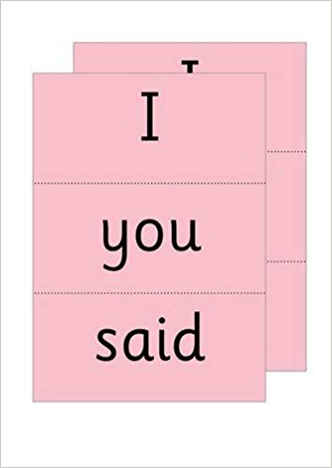
‘Red’ Words
Red Words are words that cannot be sounded out. Children learn to read them by sight. Please see more information about this in the hand-out that was given out to your child previously.

Slide 14
Some definitions
Digraph
Two letters, which act together to make one phoneme (sound) (special friends)
A consonant digraph contains 2 consonants:
sh ck th ll
A vowel digraph contains at least one vowel:
ai ee ar oy

Slide 15
Trigraph
3 letters which make one sound.
igh dge tch
high bridge watch

Slide 16
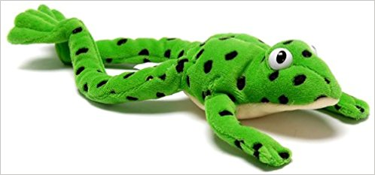
Sound buttons
rain
bright
witch
Click on the speaker icon for the voice over

Slide 17

After reading through the information sent home and watching the
recommended videos, if you are still unsure please come and speak
to us.

